Slide 1
Predicting the Occurrence of Diabetes Mellitus in the next year

Slide 2
Results
This presentation file shows the result for eight experiments
11 selected features
With the actual dataset [training class ratio is 2:2:1 for normal, prediabetes and diabetes] (Under sampling the majority )
With synthetic dataset (Oversampling or generating additional data for the minority class using KNN) [training class ratio is 2:2:1]
Ensemble of the three algorithms (stacking RF,SVM&XGBoost)
The traditional predictors (HbA1c, BMI, family history)
With the actual dataset
With synthetic dataset
Ensemble of the three algorithms (stacking RF,SVM&XGBoost)

Slide 3
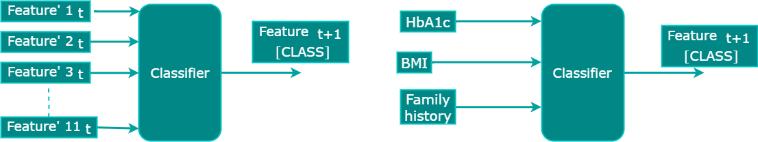
Results
The experiments follow the following architecture
1. With the selected 11 features
2. With the traditional predictors

Slide 4
Results
The dataset is split into training and testing dataset
The testing dataset contains 200 instances per class
The result contains
The 10 fold cross validation accuracy value on the training set and
The detailed result for the testing dataset

Slide 5
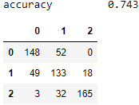
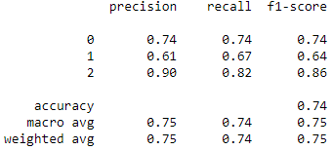
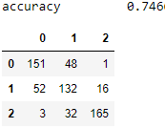
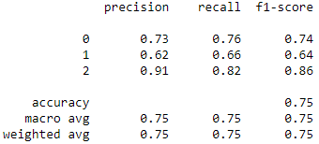
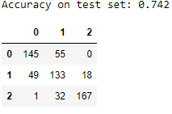
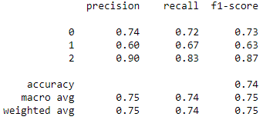
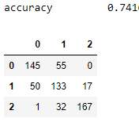
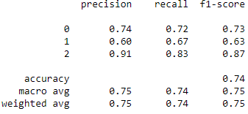
Results – 11 features with actual data
XGBoost
10 fold Cross Validation
Accuracy: 0.73 (+/- 0.01) [rf]
Accuracy: 0.73 (+/- 0.01) [xgb_model]
Accuracy: 0.73 (+/- 0.02) [SVC_clf]
Accuracy: 0.73 (+/- 0.01) [StackingClassifier]
Training data size [D=842, PD=‭1,684‬, ‭N=1,684‬]
SVM
RF
Stacking Classifier

Slide 6
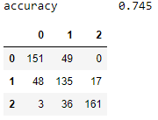
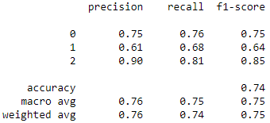
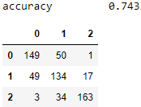
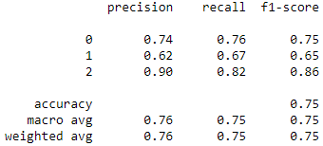
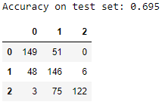
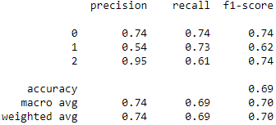
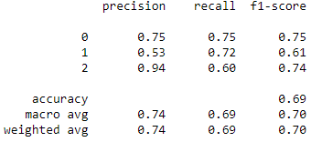
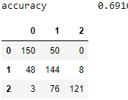
Results – 11 features with synthetic data
XGBoost
10 fold Cross Validation
Accuracy: 0.77 (+/- 0.04) [rf]
Accuracy: 0.72 (+/- 0.04) [xgb_model]
Accuracy: 0.72 (+/- 0.03) [SVC_clf]
Accuracy: 0.77 (+/- 0.04) [StackingClassifier]
Training data size [D=17,105 , PD=‭17,105 ‬, ‭N=17,105 ‬]
SVM
RF
Stacking Classifier

Slide 7
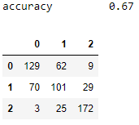
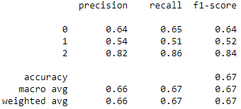
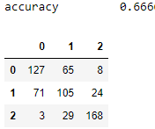
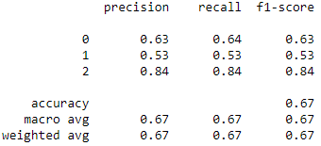
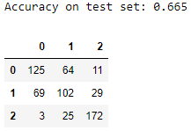
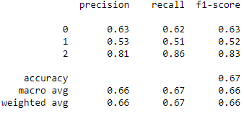
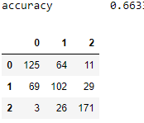
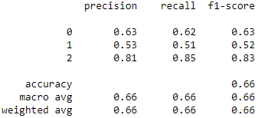
Results – traditional predictors (HbA1c, BMI, family history)
XGBoost
10 fold Cross Validation
Accuracy: 0.73 (+/- 0.01) [rf]
Accuracy: 0.73 (+/- 0.01) [xgb_model]
Accuracy: 0.73 (+/- 0.02) [SVC_clf]
Accuracy: 0.73 (+/- 0.01) [StackingClassifier]
Training data size [D=956, PD=‭1,912‬, ‭N= 1,912‬]
SVM
RF
Stacking Classifier

Slide 8
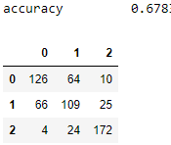
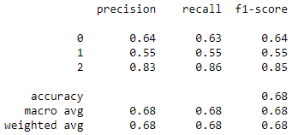
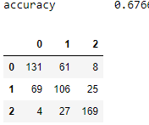
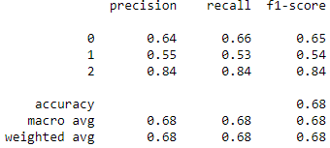
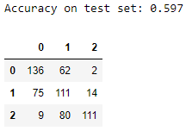
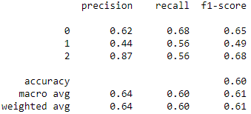
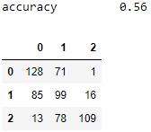
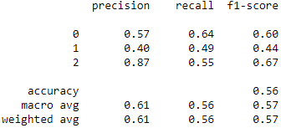
Results – traditional predictors (HbA1c, BMI, family history) with synthetic data
XGBoost
10 fold Cross Validation
Accuracy: 0.70 (+/- 0.02) [rf]
Accuracy: 0.66 (+/- 0.01) [xgb_model]
Accuracy: 0.64 (+/- 0.01) [SVC_clf]
Accuracy: 0.70 (+/- 0.01) [StackingClassifier]
Training data size [D=956, PD=‭1,912‬, ‭N= 1,912‬]
SVM
RF
Stacking Classifier

